Slide 1
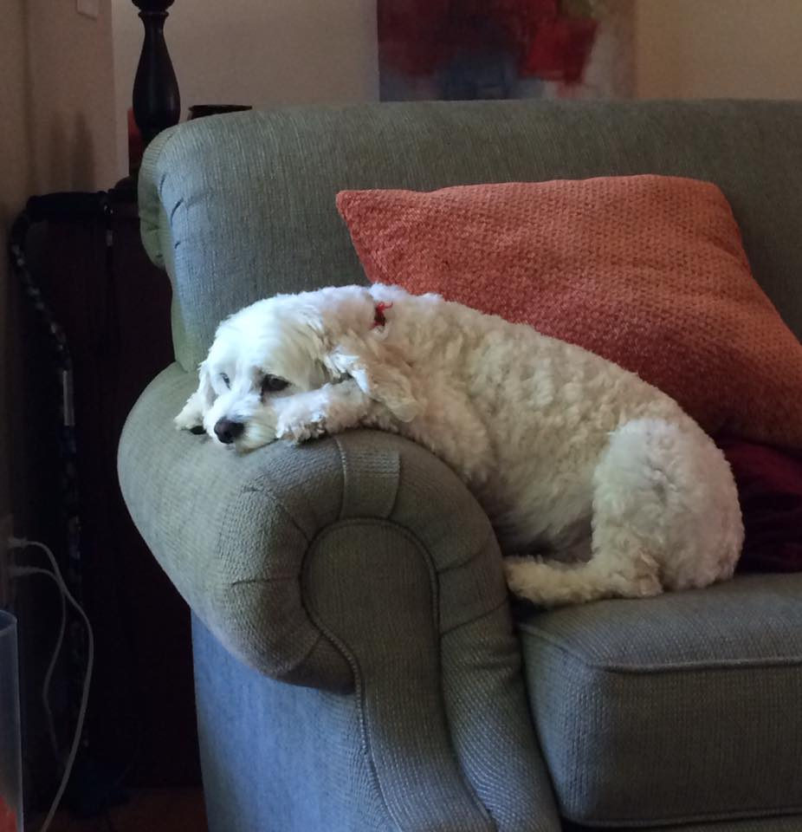
Memorizing the Twos Tables

Slide 2
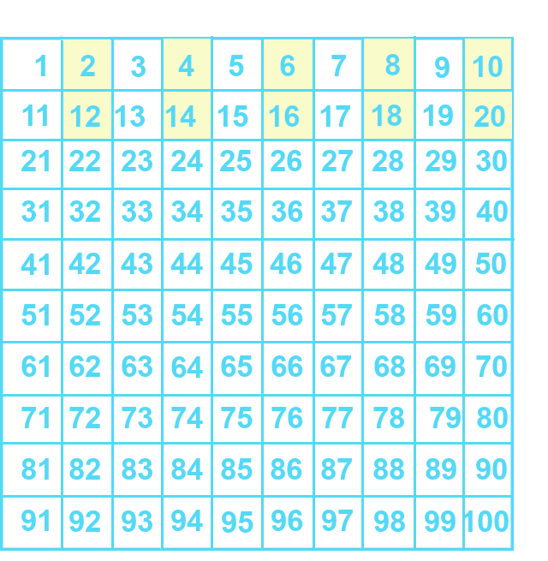
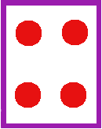
OVERLEARNING ☺ ☺
2 x 2 =
Notes:
Maybe you already know some of these. Maybe 2 x 2 = 4 is something you could say in your sleep... But maybe

Slide 3
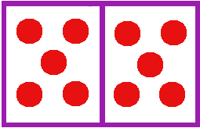

OVERLEARNING ☺ ☺
2 x 6
12
Notes:
2 x 6 isn’t quite so... Automatic. Let’s practice the twos – and then keep practicing. We want the answer to come automatically, without thinking.. It doesn’t matter exactly how fast – but it should happen without counting or calculating. You might not get all the times tables to that level, but the more the merrier!

Slide 4
OVERLEARNING ☺ ☺
Notes:
Here are the twos times tables on the number chart. Let’s zoom in on the part that matters.

Slide 5
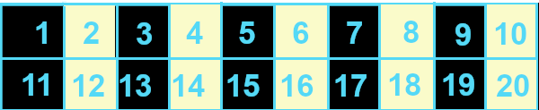
Notes:
We’re going to do a *lot* of getting answers from your brain.
You can do this without the video, too. Make this on paper. Get something to cover the numbers – a coin or a piece of paper...
Count off the facts – it’s called “skip couinting” – 2 4 6 8 10 12 14 16 18 20.
Pick a fact – say, 2 x 9 is 18.

Slide 6
Notes:
Cover it up and say it again. Then count them off again. Then cover up another.
Or, we can do them together! And remember, if you forget one, you can go back and do it again. Let’s say ‘em again.
2 4

Slide 7
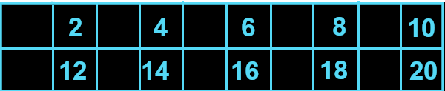
Notes:
Clear off the odd numbers... one more time 2 4 6 8 10 12 14 16 18 20...

Slide 8
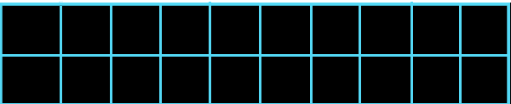
2
4
6
8
10
12
14
16
18
20
2 x 9
Notes:
Now we’re going to send one away. 2 x 10 is 20.... Back up two so 2 x 9 s 18.

Slide 9
2
4
6
8
10
12
14
16
18
20
Notes:
2 x 10 is 20.... Back up two so 2 x 9 s 18.

Slide 10
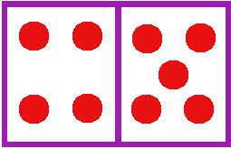
2
4
6
8
10
12
14
16
18
20
2 x 9
Notes:
Let’s send that one away.

Slide 11
2
4
6
8
10
12
14
16
20
2 x 9 = 18

Slide 12
2
4
6
8
10
12
14
16
20
2 x 9 = 18
Notes:
Who’s next? Let’s take off the halfway point. 2 x 5 is 10. Don’t forget 2 x 9 is 18. Get outta here, 10. 2 4 6 8 12 14 16 20

Slide 13
2
4
6
8
2 x 5 = 10
2 x 7 = 14
12
14
16
20
2 x 1 = 2
2 x 3 = 6
2 x 9 = 18
2 x 10 = 20
Notes:
2 x 5 is 10 2 x 9 is 18

Slide 14
2 x 9 = 18
2
4
6
8
2 x 5 = 10
2 x 7 = 14
12
14
16
20
2 x 1 = 2
2 x 3 = 6
2 x 10 = 20
Notes:
Who’s next? 2 x 5 was 10, 2 x 9 is still 18....
2 x 7, 14, ZAP!!!
2 4 6 8 _____ 12 _____ 16 _____ 20.

Slide 15
2
4
6
8
2 x 5 = 10
12
16
20
2 x 1 = 2
2 x 3 = 6
2 x 10 = 20
2 x 7 = 14
2 x 9 = 18
Notes:
2 4 6 8 _____ 12 _____ 16 _____ 20. 2 x 7 is 14 etc.

Slide 16
2 x 9 = 18
2 x 5 = 10
2
4
6
8
2 x 7 = 14
12
16
20
2 x 1 = 2
2 x 3 = 6
2 x 10 = 20
Notes:
2 4 6 8 _____ 12 _____ 16 _____ 20.
Let’s get the little onesie out. Swoosh....
____ 4 6 8 ____ 12 ____ 16 ____ 20.

Slide 17
2 x 1 = 2
4
6
8
2 x 5 = 10
12
16
20
2 x 3 = 6
2 x 7 = 14
2 x 9 = 18
2 x 10 = 20
Notes:
2 4 6 8 _____ 12 _____ 16 _____ 20.
Let’s get the little onesie out. Swoosh....
____ 4 6 8 ____ 12 ____ 16 ____ 20.

Slide 18

2 x 9 = 18
2 x 5 = 10
4
6
8
2 x 7 = 14
12
16
20
2 x 1 = 2
2 x 3 = 6
2 x 10 = 20
Notes:
Let’s lose 2 x 3 = 6, that’s fine by me. Zwop!

Slide 19
2 x 1 = 2
2 x 3 = 6
4
8
2 x 5 = 10
12
16
20
2 x 7 = 14
2 x 9 = 18
2 x 10 = 20
Notes:
Let’s lose 2 x 3 = 6, that’s fine by me. Zwop! (read ‘em off)
...

Slide 20
2 x 9 = 18
2 x 5 = 10
4
8
2 x 7 = 14
12
16
20
2 x 1 = 2
2 x 10 = 20
Notes:
Okay, we’ve gone through all of the odd multiples of 2. Let’s stop here and quiz ourselves ☺

Slide 21
2
4
6
2 x 1=
2 x 2 =
2 x 3 =
8
10
12
2 x 4 =
2 x 5 =
2 x 6 =
14
16
18
2 x 7 =
2 x 8 =
2 x 9 =
Notes:
The big guy – 6 x 9 - 54
Double Dude – 6 x 2 = 12

